Slide 1


Dr. Anupama Sharma
Master Spiritual Healer
Tao Quantum Healing
成功
3396818
San San Jiu Liu Ba Yao Wu

Slide 2


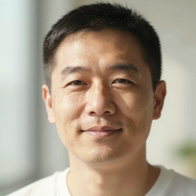



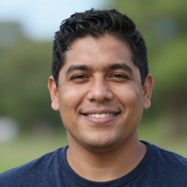

Studio Shodwe
About Dr. Anupama Sharma
Master Spiritual Healer
Tao Quantum Healing Expert
Certified Energy Practitioner
Dr. Anupama Sharma is a distinguished Master Spiritual Healer with over two decades of dedicated practice in Tao Quantum Healing. Blending ancient Tao wisdom with modern quantum principles, she guides clients toward profound transformation, inner peace, and holistic well-being.

Slide 3
The Philosophy of Tao Quantum Healing
"Healing is the art of aligning with the flow of life's energy."
– Dr. Anupama Sharma
Benefits of Tao Quantum Healing
Ancient Wisdom Meets Quantum Understanding
Tao Quantum Healing is rooted in the timeless principles of Tao — the universal flow of energy that underlies all existence. By aligning with this natural flow, the body, mind, and spirit restore their innate harmony. Quantum healing bridges this ancient wisdom with modern understanding of energy fields and vibrational resonance.
Mind & Emotional Benefits
Stress reduction and mental clarity
Enhanced emotional resilience and peace
Deep inner calm and psychological balance
At its core, this philosophy recognizes that every living being is an energetic system in constant interaction with the universe. When energy flows freely and is in alignment, healing occurs naturally. Dr. Sharma's practice channels this principle — clearing blockages, restoring balance, and awakening the body's own quantum healing intelligence.
Physical & Spiritual Benefits
Improved physical vitality and energy flow
Deepened spiritual connection and purpose
Alignment with Tao for holistic well-being

